Slide 1
CSFP Reporting: FNS 191
(Race and Ethnicity Report)

Slide 2
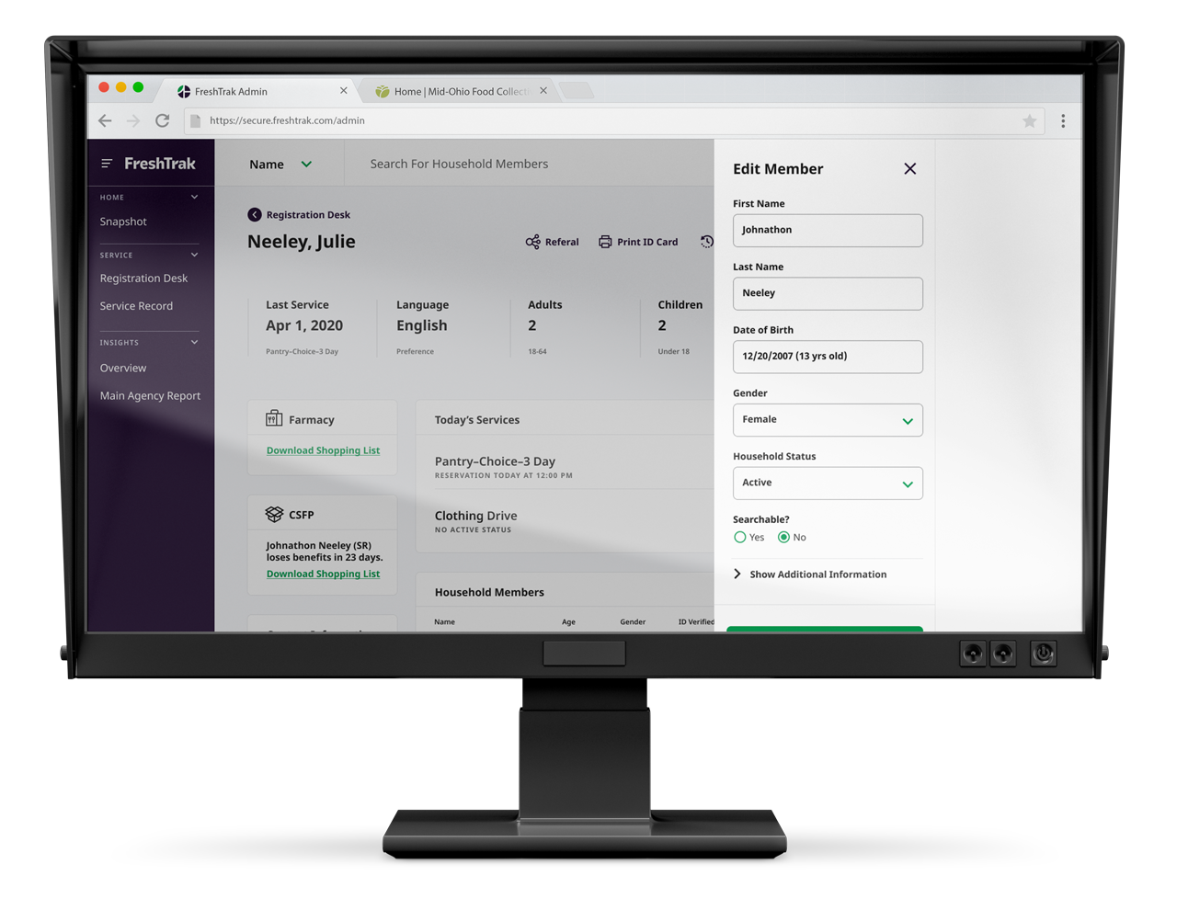
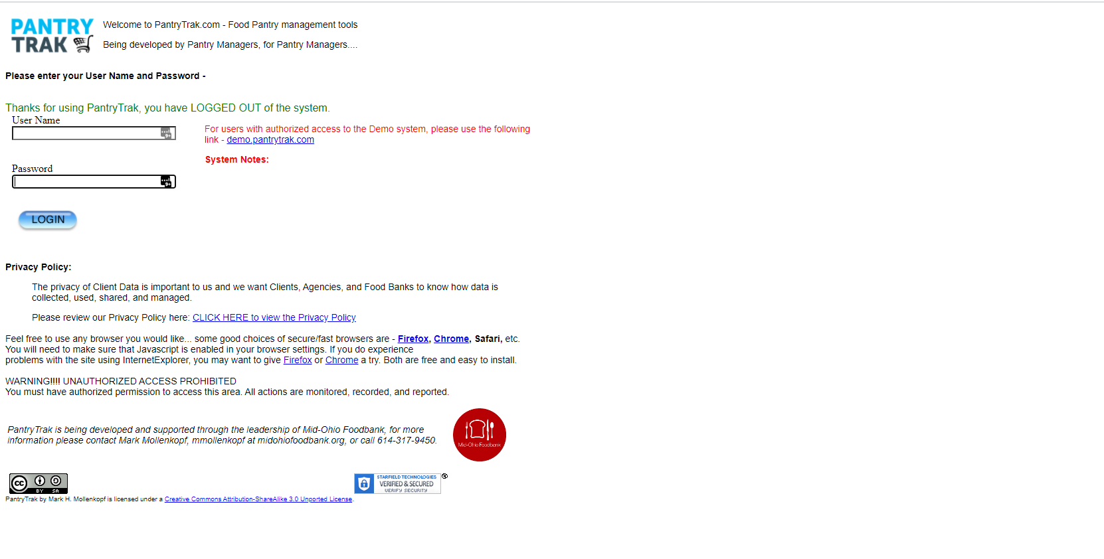
What will I need?
Internet:
  PantryTrak can be accessed anywhere there is a computer and internet connection at the url:
secure.pantrytrak.com
  A WiFi network
  Or a hotspot! Smart phones can be used as a hotspot. Running PantryTrak for an hour during a distribution typically uses less data than watching a 5 min YouTube video!
Computers:
  Laptops
  A desktop computer
  Tablets - iPad, Amazon Fire
  Cell phone

Slide 3
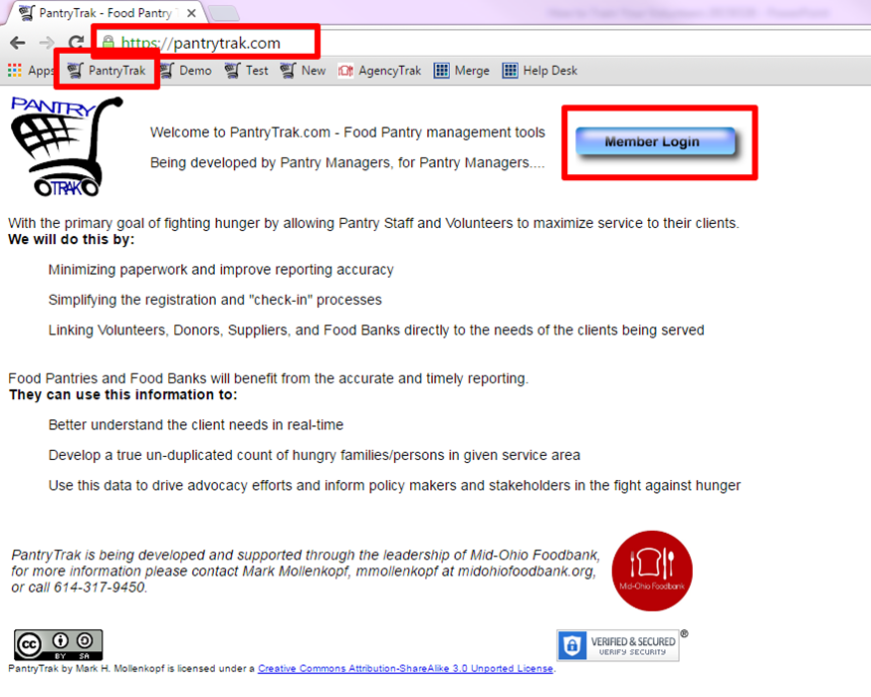
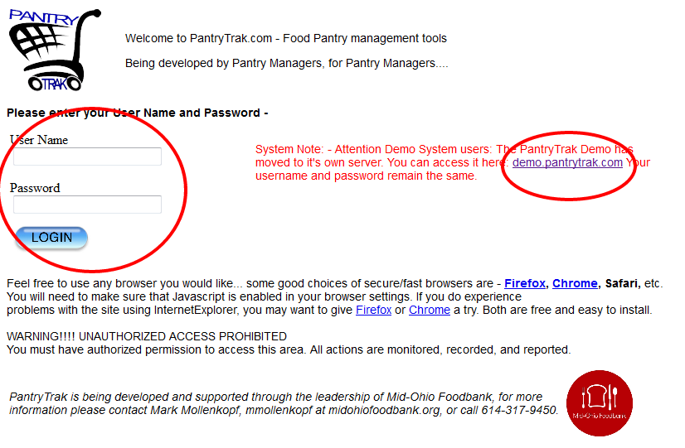
PantryTrak Login
After navigating to the website by typing the url…
Or if it’s already bookmarked..
Click the Member Login button!
The next screen will prompt for a username and password.
Click the login button
Your username and password will be provided by your agency representative

Slide 4
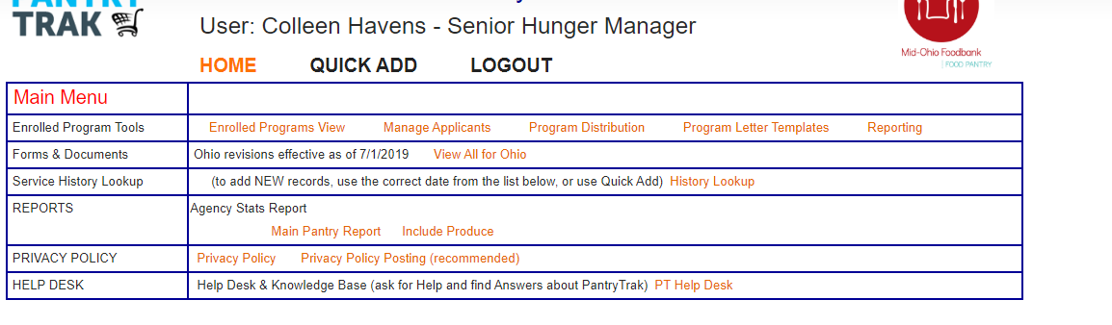
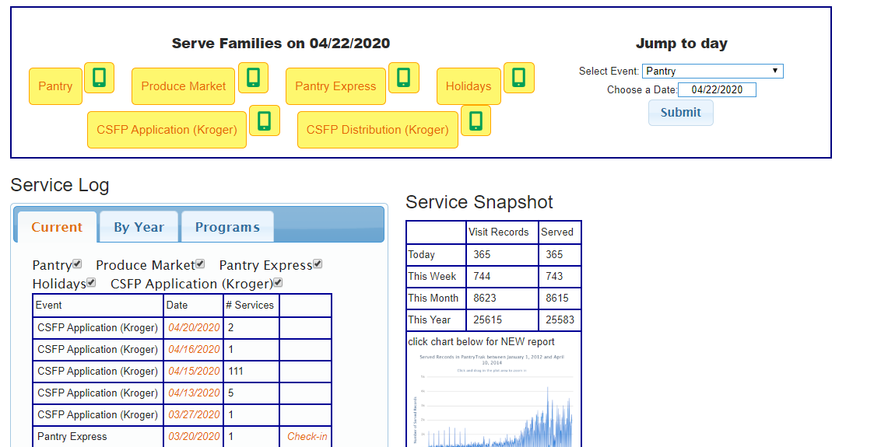
Main Screen Overview
Notice all the places you can go from your home screen.
Enrolled Programs Tools
Yellow Service Buttons
Mobile Service Button
Reports
Service Log (Current and Programs)

Slide 5
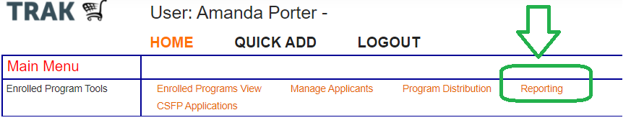
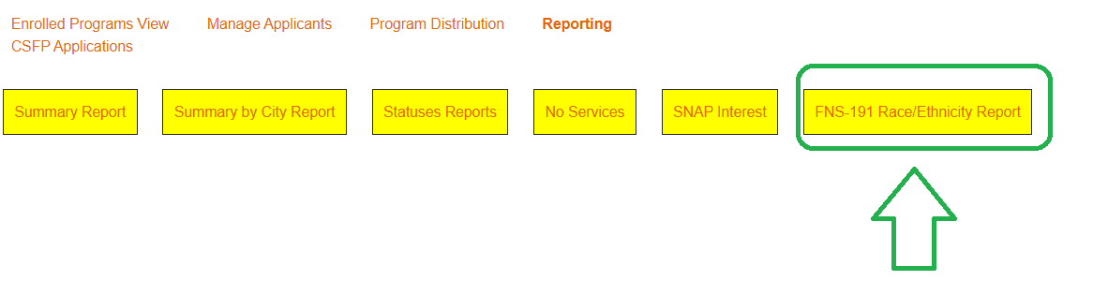
CSFP Reporting
In your enrolled Program Tools taskbar you’ll see “Reporting”. Click that link
There are a number of reports specifically to CSFP, but we’re going to focus on the FNS-191.

Slide 6
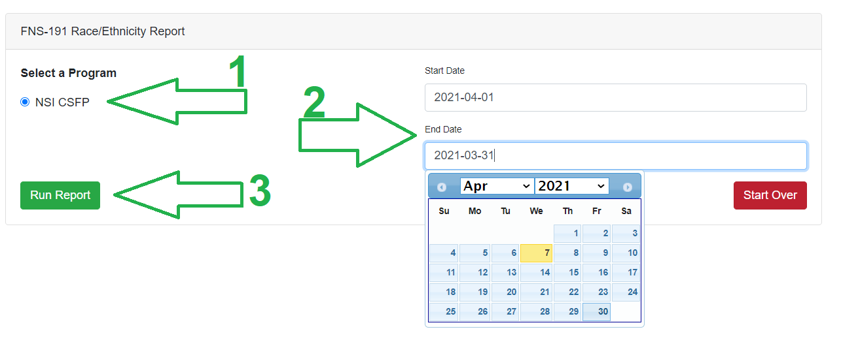
CSFP Reporting
FNS 191 (Race and Ethnicity Report)
Select your program.
Select your dates
  (usually April 1 – April 30)
Run Report

Slide 7
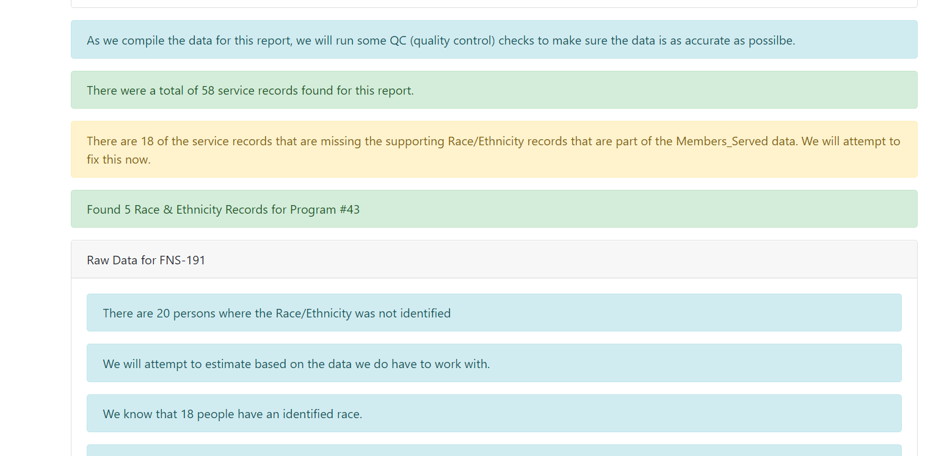
CSFP Reporting
You’ll see some information about the data being processed.
You’ll see the number of services during the time period, you’ll additionally see the number of individuals for whom race/ethnicity is not identified. The system will place these individuals in categories since this is required for compliance.

Slide 8
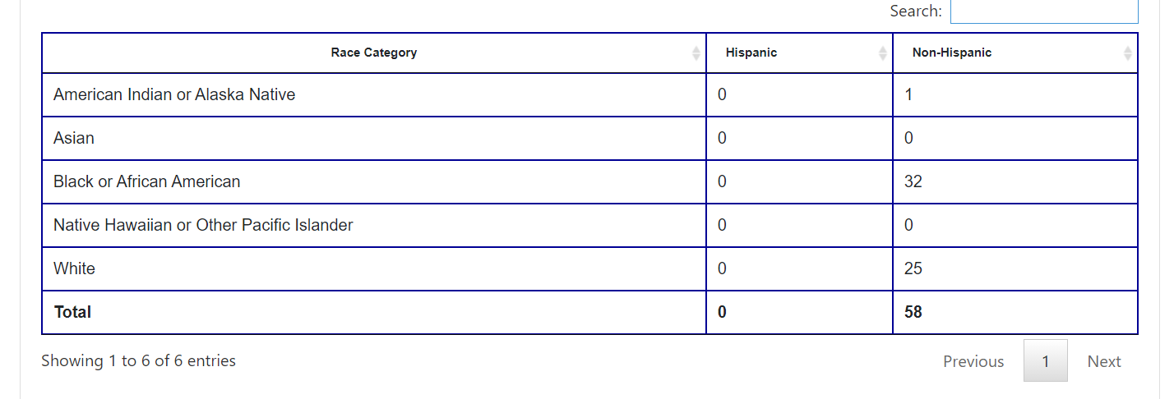
CSFP FNS-191 Reporting
About half way through the page you’ll see the report.
Add the two columns together to get your full total.

Slide 9
Questions?

